Slide 1
Development and Deployment of Azure Functions using CLI and PowerShell

Slide 2

Create a function app locally. The function app is a single unit of deployment. Azure CLI will generate the necessary config files of the function app.

Slide 3


Slide 5
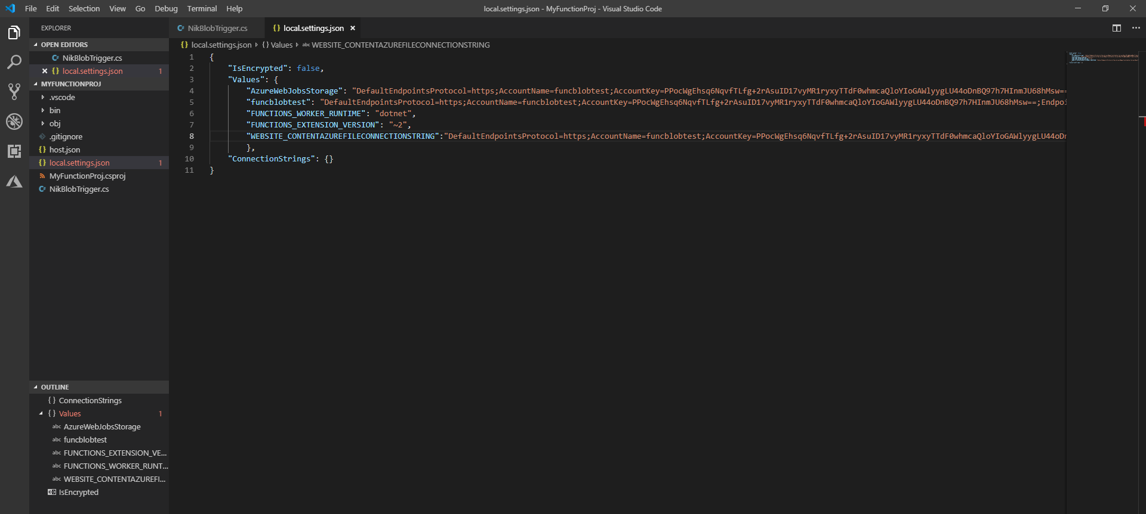

Slide 6
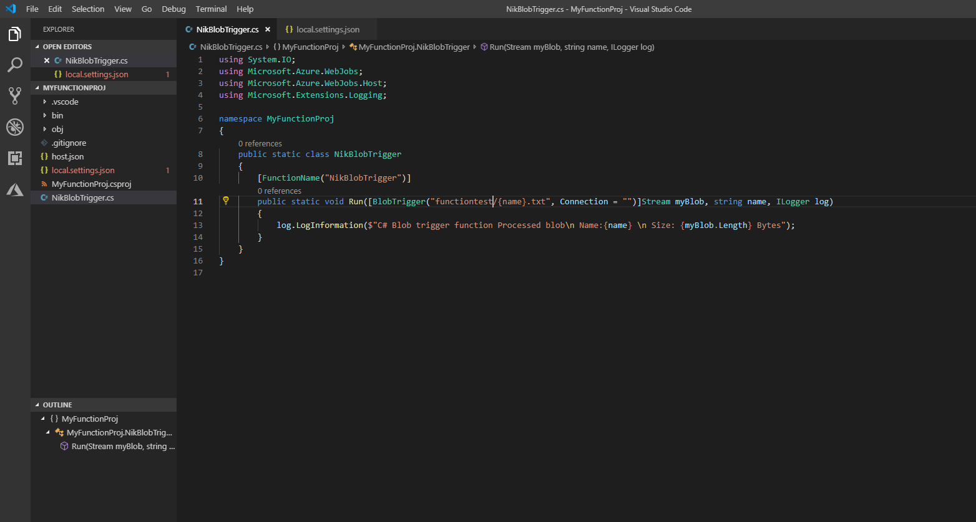

Slide 7
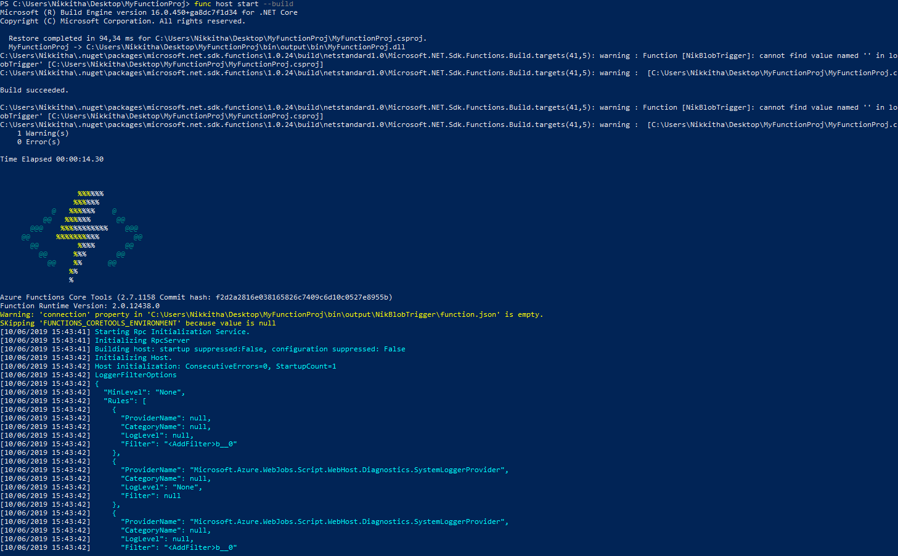

Slide 8
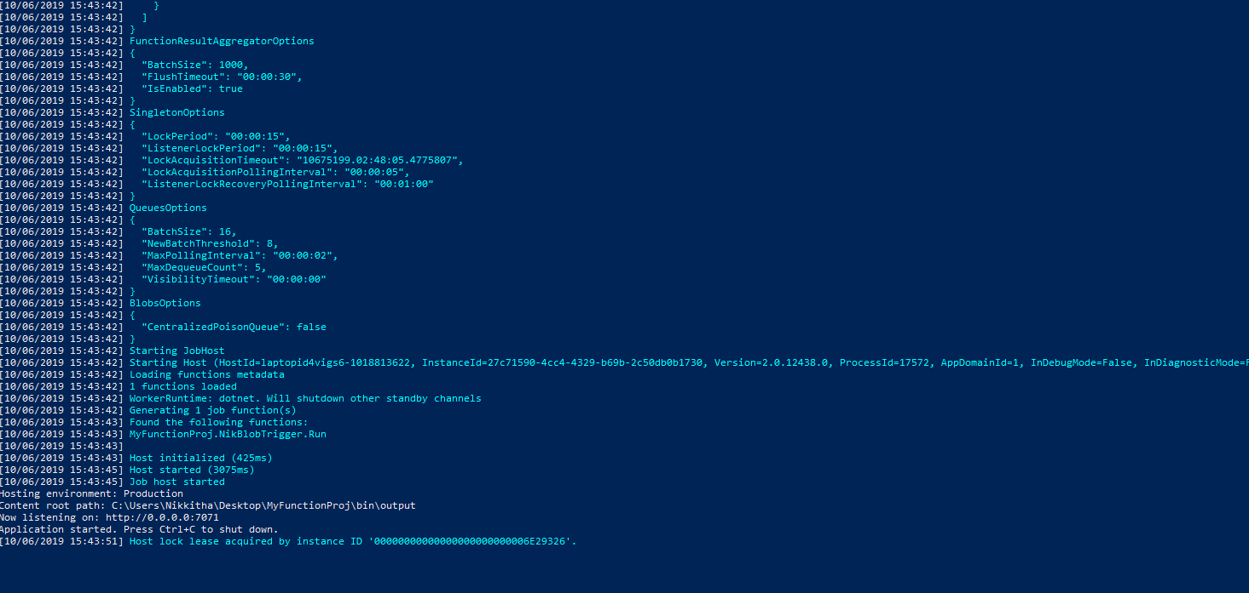

Slide 9
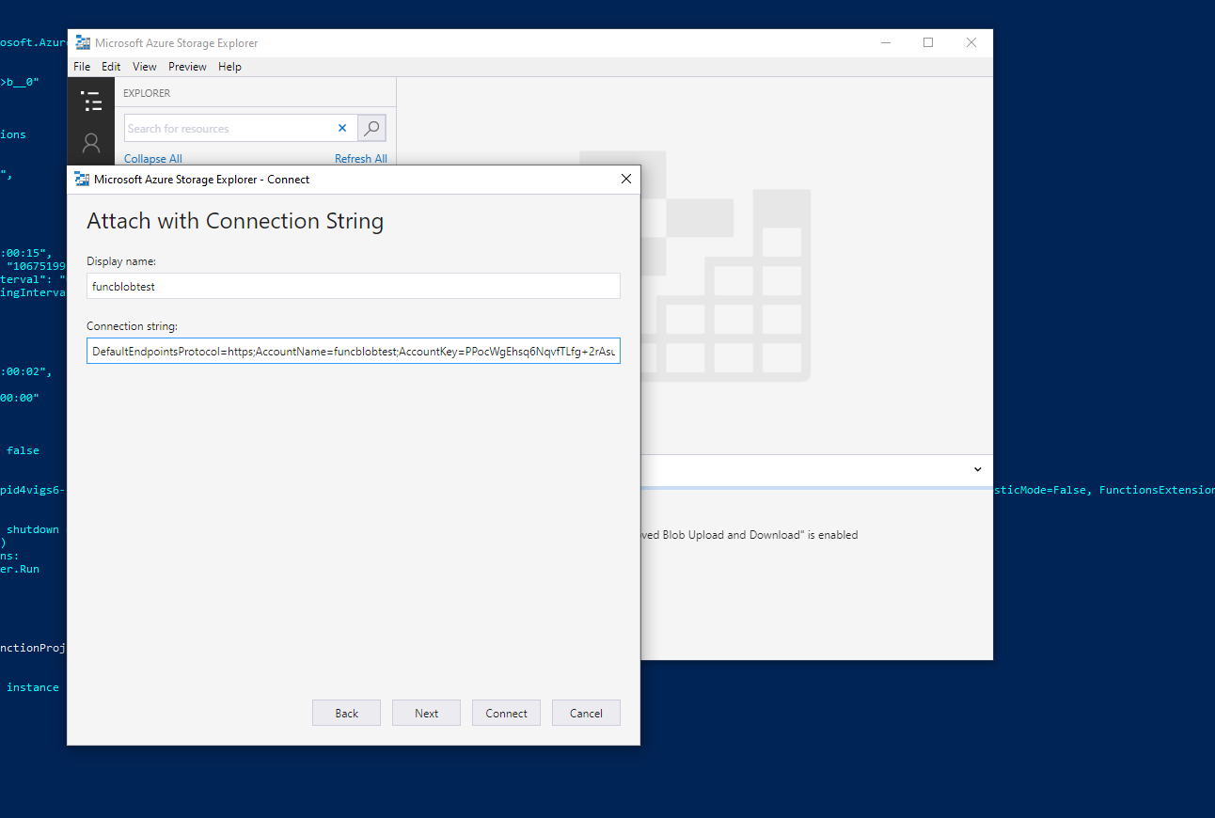

Slide 10
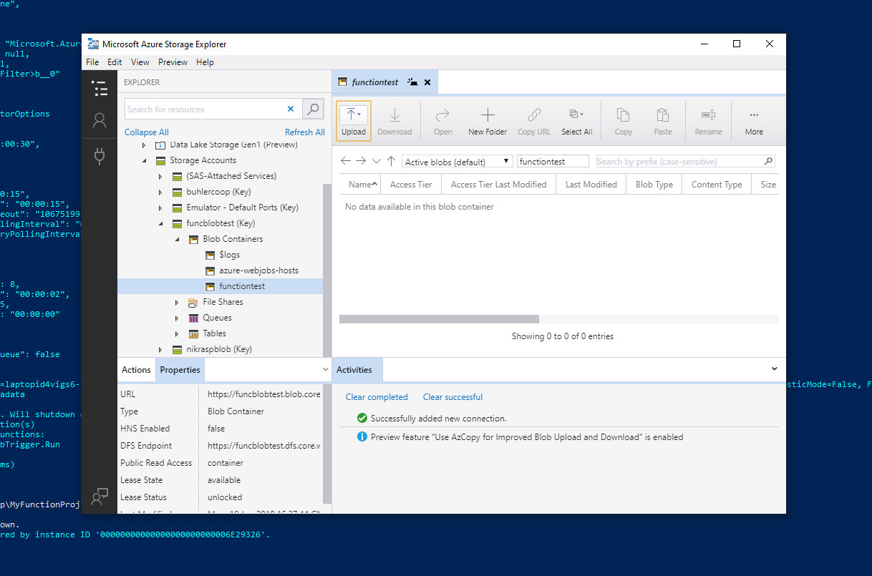

Slide 11
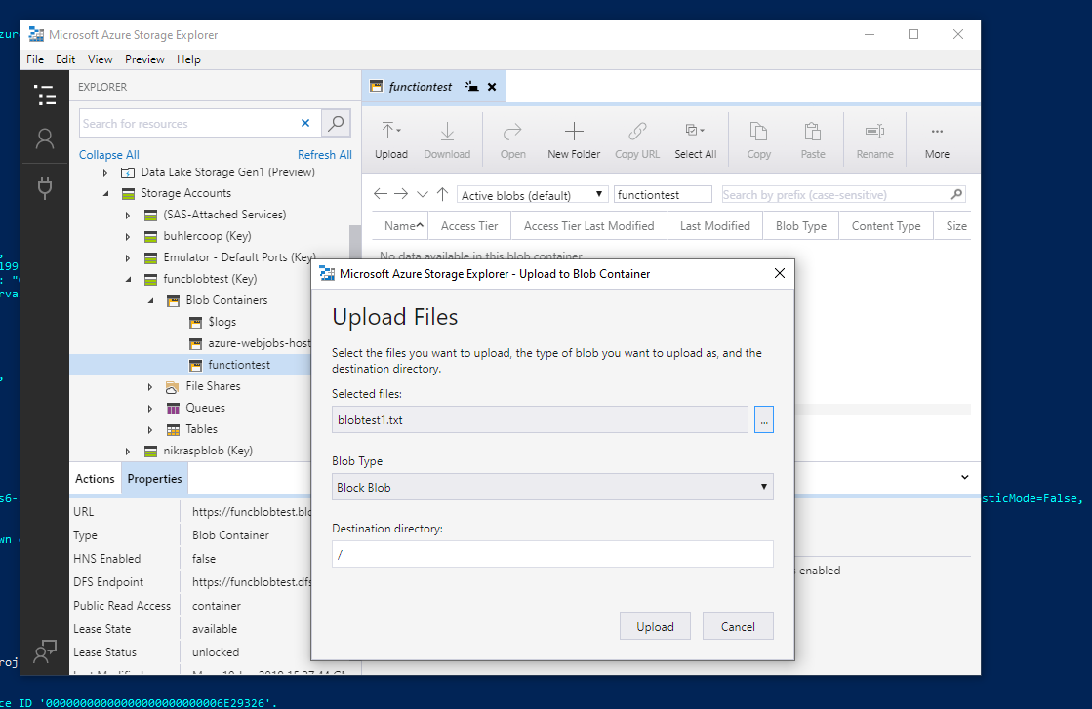

Slide 12


Slide 13
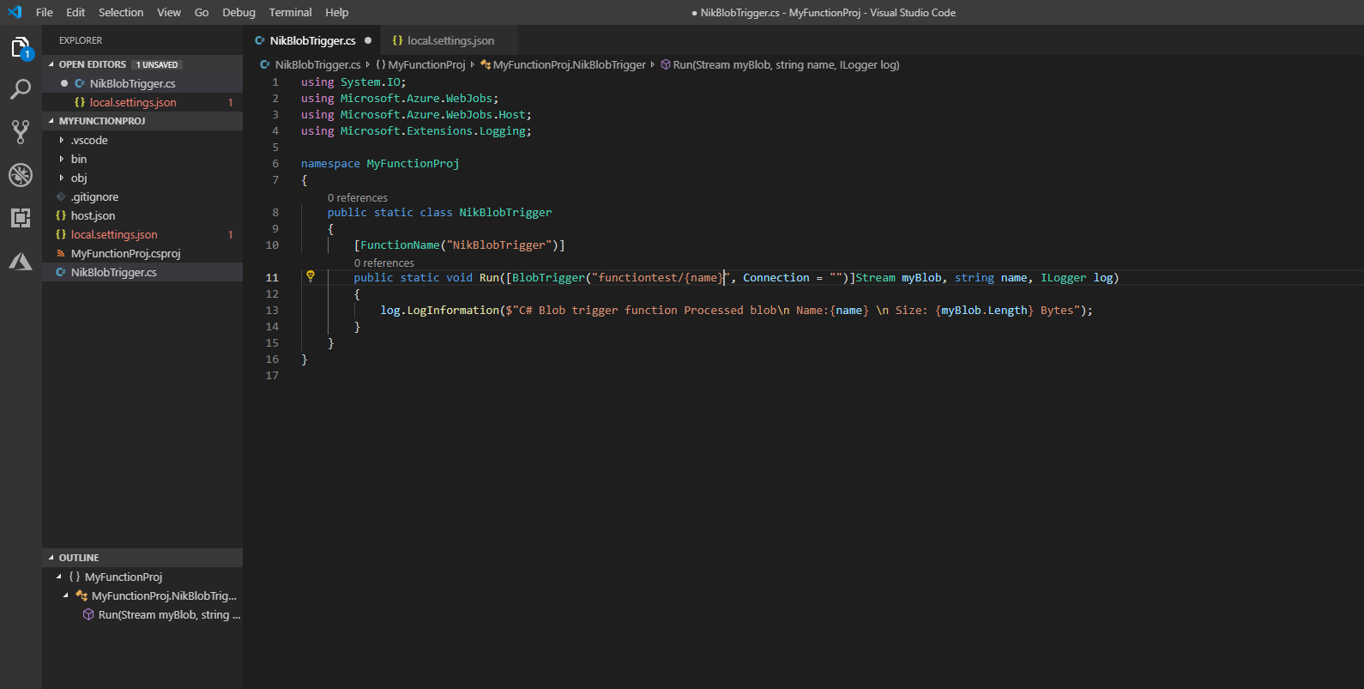

Slide 14


Slide 15


Slide 17
